Slide 1

MAZE
Customized for MAZE LLC
Vasantha Mutyala, Valense Acquah-Louis, Saiyid Kazmi, and Debra Potts

Slide 2
Table of Contents
Customized for MAZE LLC
Intro (Team)
Dashboard
Sources of Data
Deployment
Technologies Used
Cleaning Process

Slide 3

Intro
Team
Today we are going to tell the story of data through analyzing the nations Museums, Zoos, Aquariums and Nature Centers. With data comprising of 33,000+ sites scattered across the country, we delved into the regions and explored these sites. After extracting and formatting publicly available data from Kaggle and government sources, we restructured the data and developed various dynamic visuals to display information about these significant sites. Let's get into the details and help you plan your next trip.
Saiyid K.
Vasantha M.
Valense A-L.
Debra P.

Slide 4
Sources of Data
1
Museums, Aquariums, and Zoos
https://www.kaggle.com/imls/museum-directory?select=museums.csv
2
Census Data https://www2.census.gov/programs-surveys/popest/datasets/2010-2020/counties/totals/
3
State FIPS https://www.census.gov/library/reference/code-lists/ansi/ansi-codes-for-states.html
4
County FIPS https://www.nrcs.usda.gov/wps/portal/nrcs/detail/national/home/cid=nrcs143_01369
5
Additional Museum Data https://www.kaggle.com/annecool37/museum-data

Slide 5
Technologies Incorporated

Slide 6
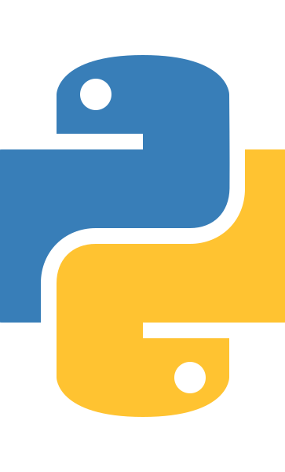

Technologies Used
01
PostgreSQL
Python, Flask, Jinga
HTML/CSS
Bootstrap
JavaScript
JQuery

Slide 7
Technologies Used
PostgreSQL
PostgreSQL, also known as Postgres, is an open-source relational database management system emphasizing extensibility and SQL compliance. We used Postgres as our database to store our data in the form of relational tables..
Python, Flask, Jinja
We created a python-flask powered application, a multi-visual dashboard that connects to PostgreSQL database to retrieve data for the dashboard.
We used Jinga which is fast, expressive, extensible templating engine. Special placeholders in the template allows writing code similar to Python syntax . The template was passed data to render the final document.
Bootstrap
Bootstrap is a free and open-source CSS framework directed at responsive, mobile-first front-end web development. This incorporates CSS and HTML which we used to template the page as well as features like carousel.

Slide 8
Technologies Used
HTML/CSS
Used HTML forms to create user selection lists. Used custom CSS for styling our dashboard.
JavaScript
JavaScript was a tough one. With all the dynamic graphs that change based on user selection, we used Plotly and Leaflet to create the visuals you can see within the dashboard.
JQuery
We used JQuery to handle form submission. jQuery is a JavaScript library designed to simplify HTML DOM tree traversal and manipulation, as well as event handling, CSS animation, and Ajax.

Slide 9
Cleaning Process Explained
02
Source Data as CSV
Transform(Fill in the Gaps)
Transform(FIPS)
Transform(N/A)
Cleaned
All of our data is derived from kaggle and census data compiled by the US Govt. Moreover, we used previously formatted data that distinguishes counties, states, etc.
After identifying the fields that are required. We populated the N/A values with latitude and longitude that we retrieved using Google geocode API. We used reverse geocoding for some records to retrieve address based on their coordinates.
For records that had missing county FIPS_Code, we used a different strategy where we used the lat/lng to derive the county FIP values.
Finally, we ensured that all the records are clean and accurate transforming our 33073 records to approximately 33030 records.
After cleaning the data frame, we exported the file as a CSV, preparing it to be loaded to PostgreSQL where our application will extract data from.
1
2
3
4
5

Slide 10
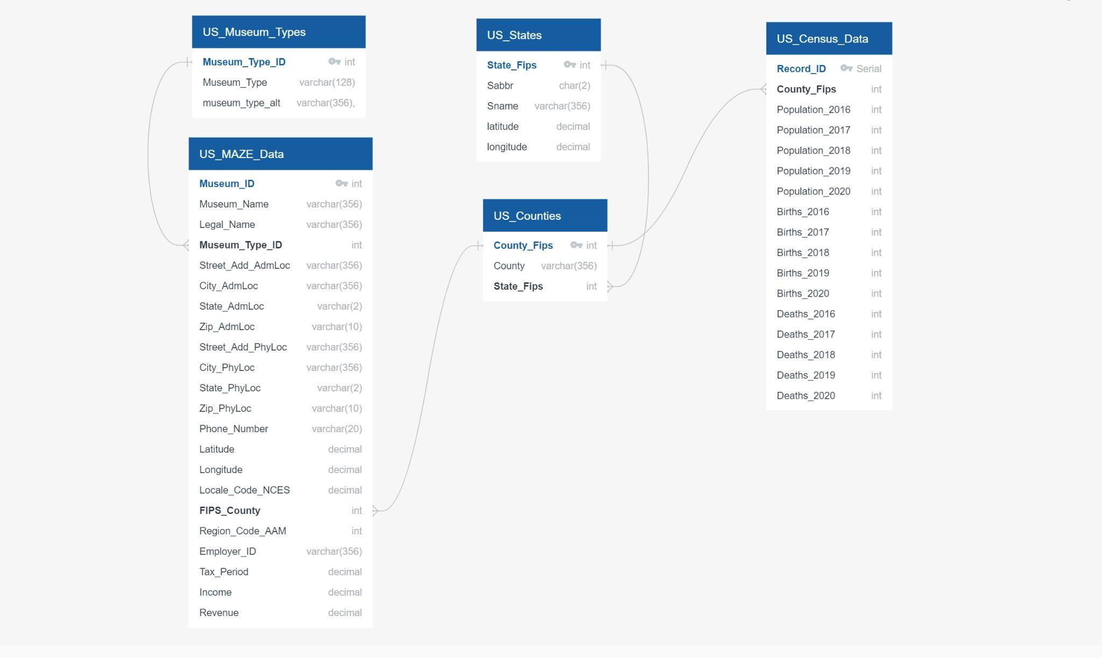
ERD

Slide 11
Dashboard

Slide 12
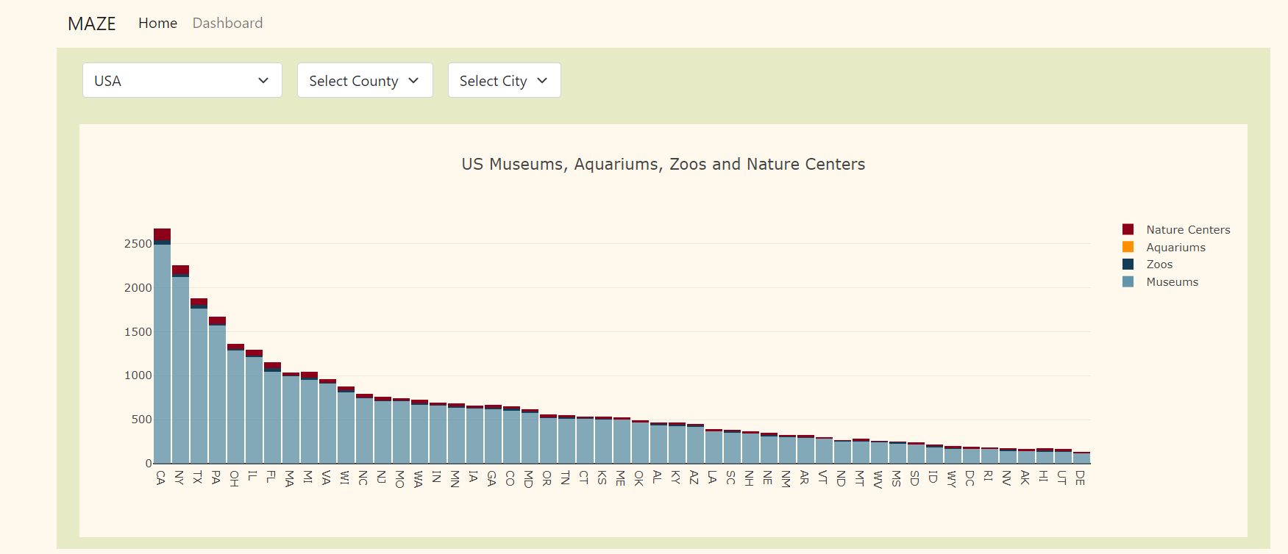
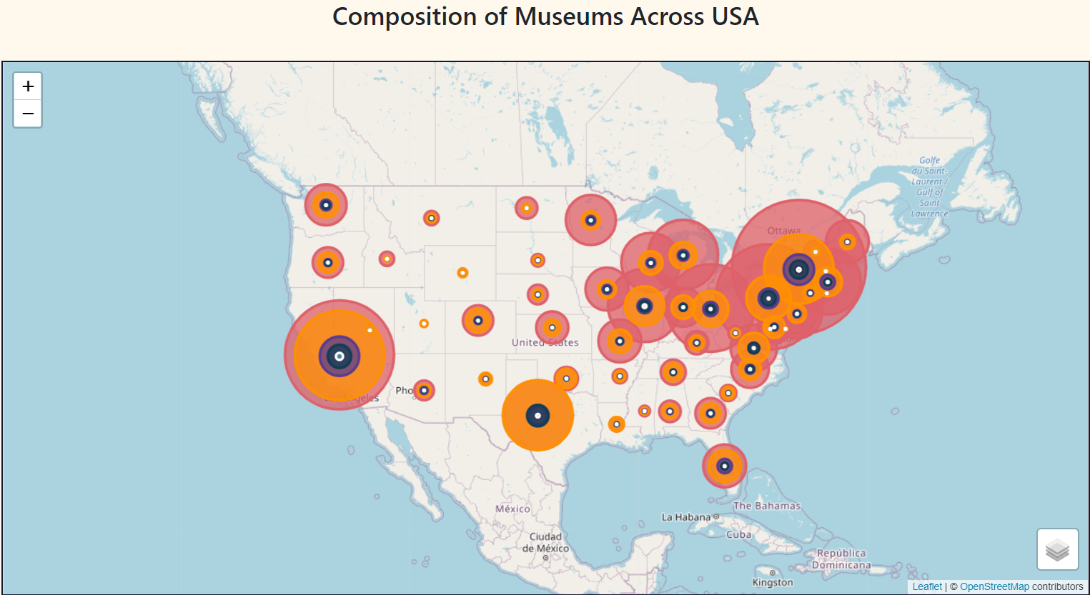
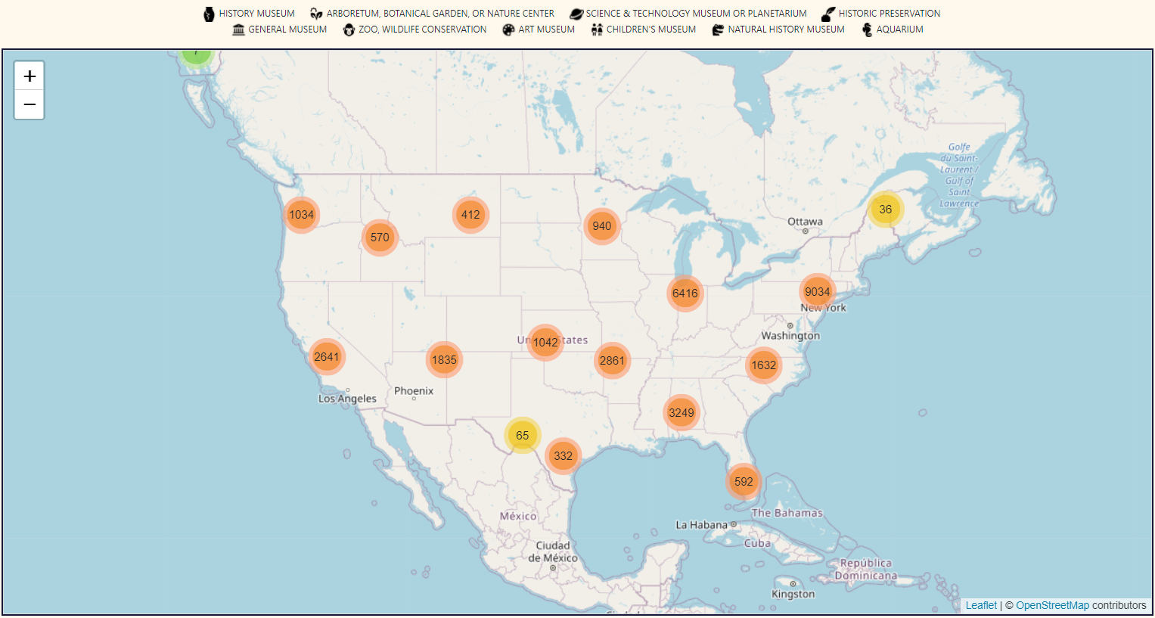
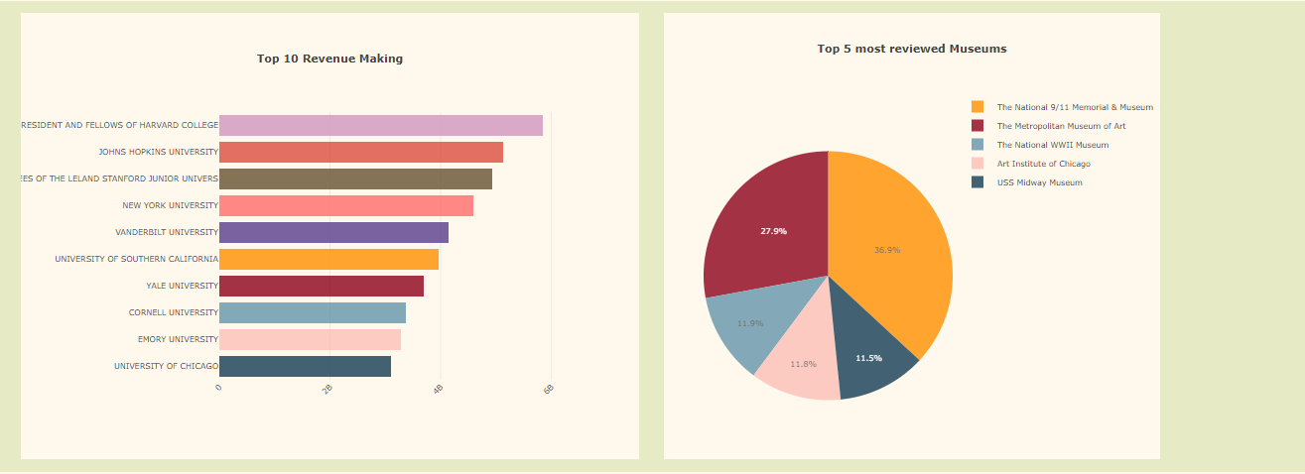

Slide 13
Deployment
Heroku is a cloud platform that lets companies build, deliver, monitor and scale apps — we're the fastest way to go from idea to URL, bypassing all those infrastructure headaches. It’s services support several programming languages allowing us to deploy a site as we attempted to do.
Phases:
Prepared database by creating Schema
Systematically imported tables and views
Created required files for Heroku (requirements.txt, runtime.text , Procfile etc.)
Set up environment variables
Changed the connection string to the database in our app
Pushed all our files to GitHub and Deployed!
TOO EASY!!!

Slide 14
Thank you.
Any Questions?

